Slide 1
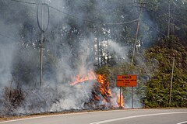
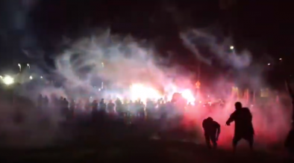
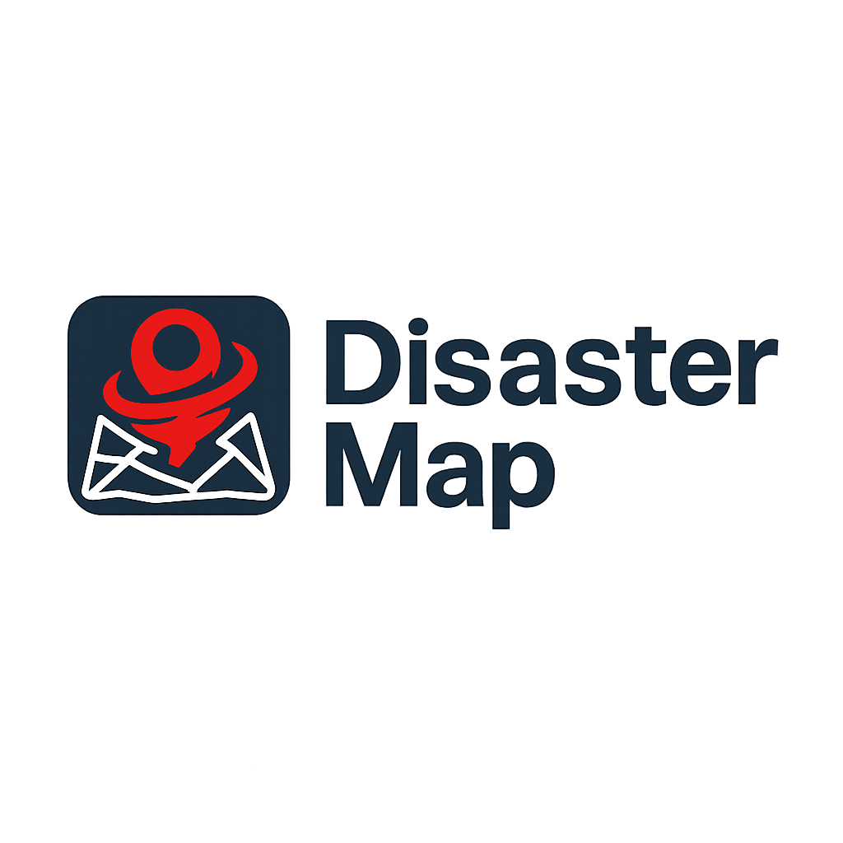
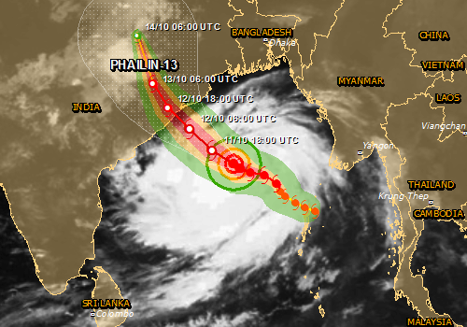


Slide 2

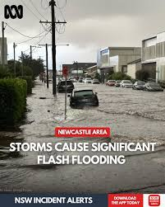
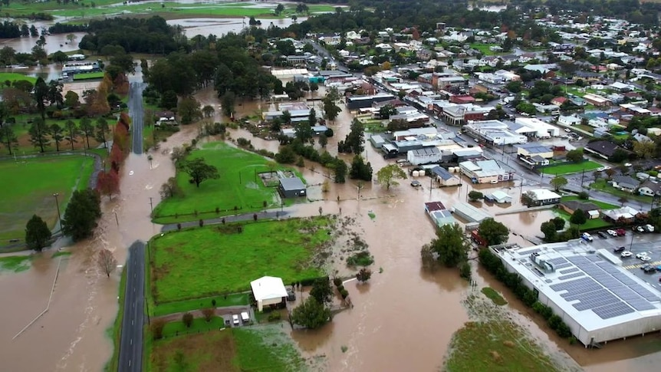
Target Customers:
Commuters
Travellers
Logistics Companies
Government Agencies
SES
“I’ve been driving around for 7 hours trying to find a way north and all the navigational apps have been wrong” – (Post seen on Facebook)
Concept: During major weather events, users can view, and report hazards they have witnessed including exact locations, descriptions and images.
May 2025 Newcastle-Mid North Coast Floods
Solving the issue
The Disaster Map can provide users of the road with vital information before starting their commute. Unlike navigational apps, users can identify the roads that are blocked due to flooding, fallen trees etc.

Slide 3
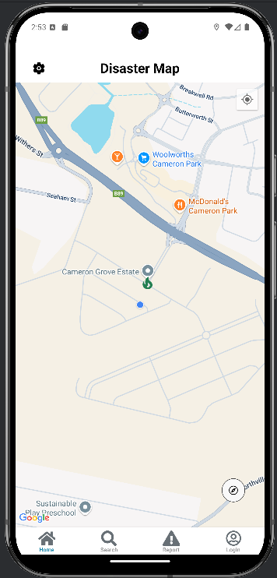
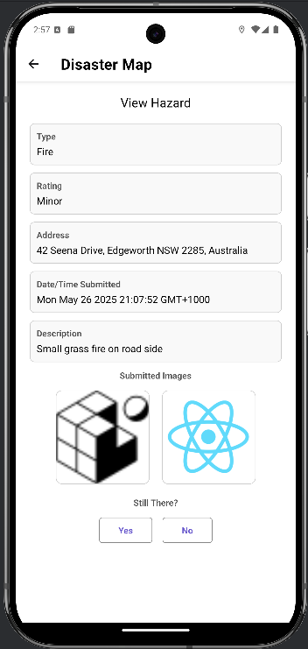
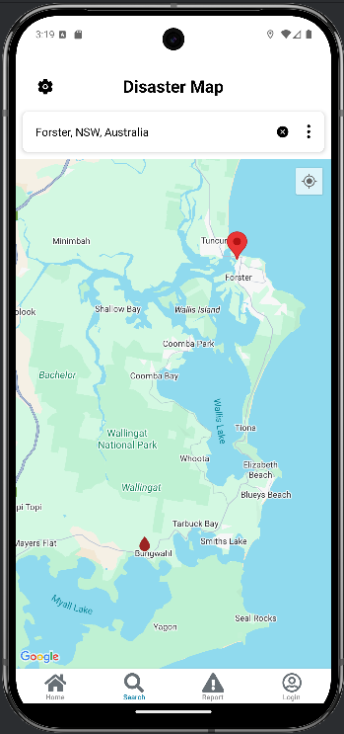
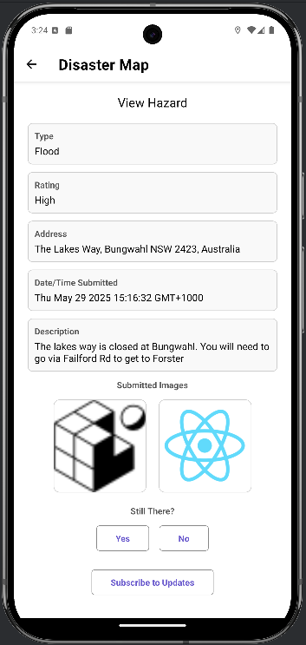
Firebase Technologies
Authentication
Firestore
Test Lab
User Story: As a user who lives in Newcastle, I want to travel north to Forster. I want to check if there are any hazards along the way.
Hazards older than 3 days will be filtered out. If a hazard receives more than 5 “No” votes, the hazard will be filtered out.
Upon loading the app, a hazard appears within 50km radius of my location
A user can search any area they like to see if any hazards are in the area
A user can see the details attached to this hazard by selecting the droplet icon on the map
Data is retrieved from the Firestore table
User can click the hazard icon to see the hazard details
User can mark the hazard if it’s still there
A user can navigate to the Search page to find hazards in other areas
A user can identify a hazard on the map indicated by the droplet “flood”
A user can identify that “The Lakes Way is closed” based on the description and can find an alternative route before leaving
Notes:
Talk about the use of the global standards for hazard colours on the icons.

Slide 4
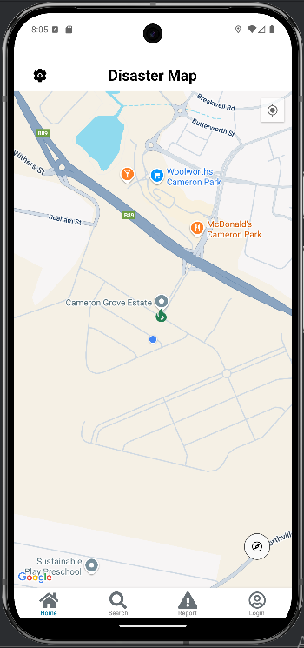
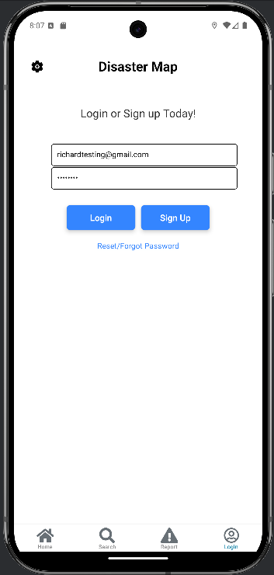
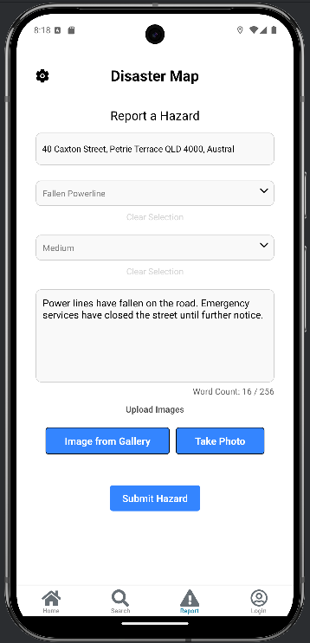
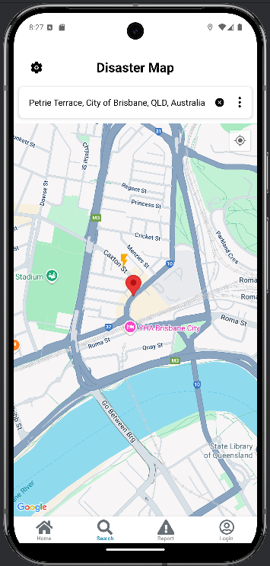
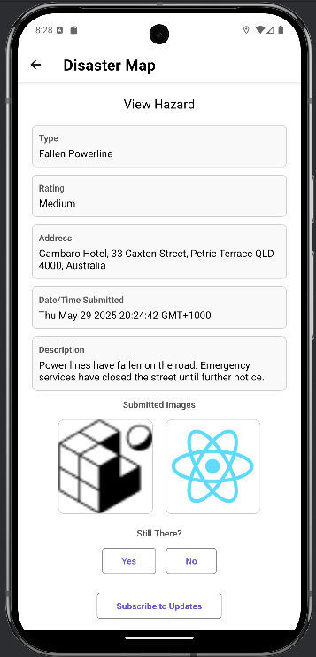
Firebase Technologies
Authentication
Firestore
Test Lab
User Story: As a user, while travelling, I noticed a hazard I would like to report. I would also like to “Subscribe” to track the status of this hazard as it’s along my regular commute route.
Hazards older than 3 days will be filtered out. If a hazard receives more than 5 “No” votes, the hazard will be filtered out.
Utilising Firebase Authentication, if the email does not exist, you will need to sign up first
The user can enter the street or address where the hazard has taken place.
A user can read the details originally submitted for the hazard
A user can add in the type of hazard
A user can add in the hazard severity rating.
A user can add a description of the hazard.
A user can enter their email address and a password. They can Login or Signup depending on their status.
A user can take photos and submit them for a better visual
A user can navigate to the login page to report a hazard.
When a user has logged in, they can navigate to the report page
When a user has completed filling out all fields (If not all fields completed, a message will appear upon submission to do so) they can submit the hazard to the Firestore database.
A user can select the hazard icon to receive more information and the ability to subscribe
A user can subscribe to updates. Any updates provided by a verified account will now be sent to the user as a push notification.
Notes:
Briefly touch on the admin page functionality as an extra piece.

